Slide 1
528 Database Security
October 21, 2015
Securing BigData Research Paper
By Prasanthi Mandava

Slide 2
Securing BigData – Table of Content
Introduction
Big Data
Characteristics of Big Data:
Need for Securing Big Data
Securing big data in Hadoop
Hadoop Architecture/components
Challenges involved in Hadoop to secure data
Token Based Authentication
Secured Communication
Data Encryption at rest and motion
Monitoring Logs
Securing big data in MongoDB
MongoDB components
Data Encryption
Authentication
MongoDB Auditing
Comparison of Hadoop/MongoDB based security
Conclusion

Slide 3
Securing BigData
Goal/Introduction:
Big Data involves managing or processing of large amounts of data. To process this massive amounts of data organizations use big data tools such as Hadoop and NoSQL databases.
Big Data:
Big Data comprised of large sets of data, ranging from few terabytes to many zettabytes of data.
This data could be from different sectors such as banking, health care, and retail etc.
Refers to collecting, storing and processing of large data sets of data

Slide 4
Securing BigData
Characteristics of Big Data:
Volume: In this case the volume of the data generated is very important. Size of the data is considered in determining whether it is Big Data or not.
Variety: The category to which data belongs is also an important fact that needs to be identified by data analysts.
Velocity: How fast the data is generated and processed, analyzed.
Need for Securing Big Data:
Big Data is stored and processed in Data Centers/ big data tools such as Hadoop or MongoDB.
Shared with different computers or transferred across network.

Slide 5
Securing BigData
Hadoop Architecture/components: Hadoop is an open source project written in java to implement MapReduce programming model for scalable, reliable and distributed computing .
Hadoop File System (HDFS):
Most of the file system used by Hadoop is Hadoop File System (HDFS).
Managed by a master/slave architecture.
Master program is termed as NameNode.
Slave programs are termed as DataNodes.
NameNode:
NameNode keeps track of data that is spread across DataNode.
Also called as a ‘bookkeeper’.
DataNode: DataNode does the grant work of read and write request from HDFS file system’s clients.

Slide 6
Securing BigData
MapReduce:
MapReduce is a programming model which splits massive amount of data sets into chunks of data.
Extensively used in the industry to process larger sets of data.
Organizations that uses MapReduce model are Amazon, Yahoo, Facebook and Google.
Challenges involved in Hadoop to secure data:
HDFS is not a traditional client/server model of processing data. Here no server to process the data, authenticate the users or to manage locking.
Users who has the access to the server running NameNode processes and having permission to the Hadoop binaries can get data from NameNode and delete the data.
Data transferred over network is not encrypted.
Hadoop doesn’t encrypt the data stored on disk and this can expose the data to attacks.

Slide 7
Securing BigData
Methods for Improving BigData Security in Hadoop:
Token Based Authentication: Kerberos is often used with Hadoop to provide authentication.
Kerberos Authentication:
Kerberos is an authentication protocol for ‘trusted hosts on untrusted networks’.
Kerberos undertakes that all the hosts it’s communicating with are to be trusted and that the secret is not compromised.
Steps involved in Kerberos authentication process:
The Authentication Server grants the user a TGT (Ticket Granting Ticket) as an authentication token. This TGT is valid only for a specific time.
The client uses credentials to decrypt TGT and then it uses the TGT to get the service ticket from the Ticket Granting Server to access a ‘Kerberized’ service. A client can use the same TGT for multiple TGS requests until TGT expires.
User uses the service ticket to authenticate and access a specific Kerberos-enabled service.

Slide 8
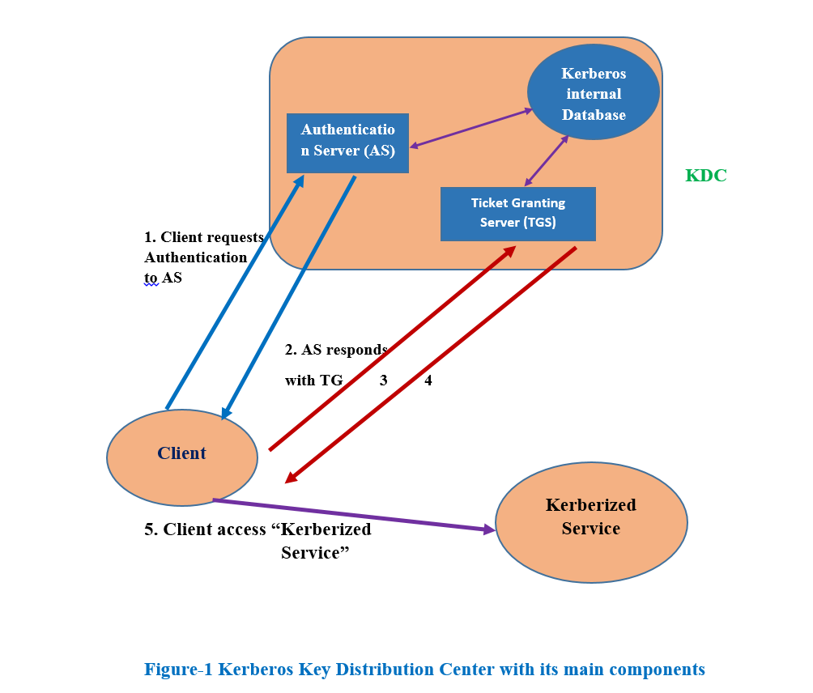
Securing BigData

Slide 9
Securing BigData
Secured Communication:
Communication between nodes in Hadoop uses RPC (remote procedure call), TCP/IP and HTTP protocols.
RPC is used for communication between NameNode, JobTracker, DataNodes and Hadoop clients.
Reading and writing of file data between clients and DataNodes uses TCP/IP protocol, which is not secured and is vulnerable for attacks.
Encryption of Inter-process Communication:
RPC protocol is used for inter-process communication in Hadoop. This communication includes between Hadoop client and HDFS and between Hadoop services such as JobTracker and TaskTracker or NameNode and DataNodes.
Encrypting HTTP Communication:
Hadoop uses HTTP protocol communication for web consoles, communication between NameNode and for MapReduce data shuffle.

Slide 10
Securing BigData
Securing Data Communication:
Data transfer between clients and DataNodes uses the Hadoop Data Transfer protocol.
SASL handshake or wrapper is needed for encryption of data transfer.
Wrapper can be enabled by setting dfs.encrypt.data transfer to true hdfs-site.html configuration file.
Data Encryption at rest and motion:
Hadoop distribution doesn’t provides encryption at rest, major vendors offers third-party solutions.
Data encryption using Amazon Web Services.

Slide 11
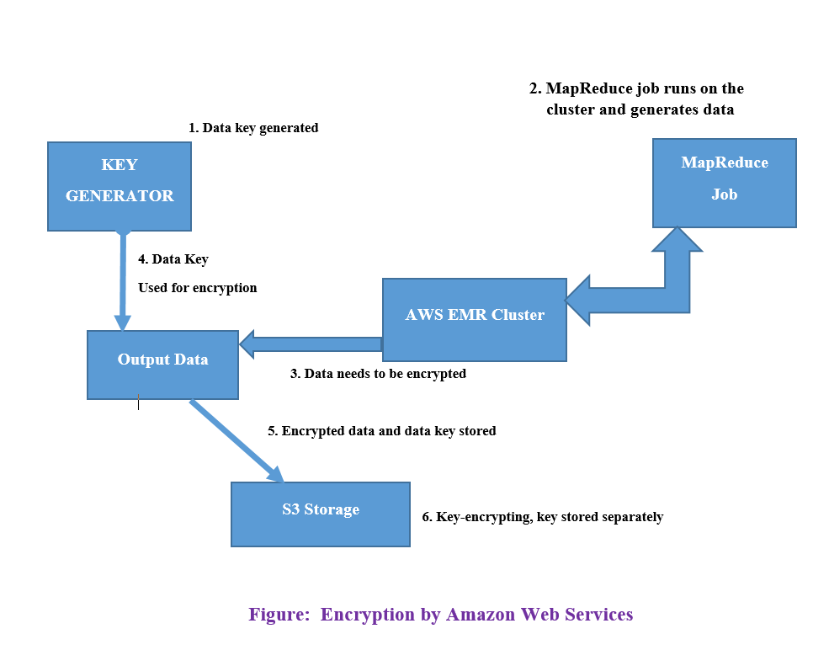
Securing BigData

Slide 12
Securing BigData
Monitoring Logs:
Audit Logs: Captures all access to HDFS and the MapReduce audit log, which captures all the jobs submitted for a Hadoop cluster.
Hadoop Daemon Logs: Generated by Hadoop daemons such as NameNode DataNode, Secondary NameNode, JobTracker, TaskTracker and ResourceManager.
Correlating Logs using User Name: List of users accessed a particular ticket or job can be retrieved and observed for security purpose.
Correlating logs using Job Name: Job name can be used to relate multiple logs to get the details of the activities performed for a particular job.

Slide 13
Securing BigData
Securing BigData with MongoDB:
MongoDB components:
MongoDB is an open-source, document-oriented database designed for ease of development and scaling.
Stores data in documents form, such as JSON or XML documents.
Documents are similar to structures in programming that associate keys with values such as hashes, maps etc.
MongoDB stores documents in collections.
A collection is a group of documents that have a set of shared common indexes.
Data Encryption:
Data encryption at rest means encrypting the data files at rest. Encryption of files is important for securing the data.
Two types of encrypting data at rest with MongoDB:

Slide 14
Securing BigData
1. Application Level Encryption:
Application level encryption provides encryption on a filed level or per-document level encryption.
To secure or encrypt data at document or field level data, Volumetric Data Security Platform can be used.
2. Storage Encryption:
Storage Encryption encrypts all the data stored in MongoDB or operating system to make sure that only authorized processes can access the data.
Third party tools : Volumetric Data Security Platform
Linux Unified Key Setup
IBM Guardium Data Encryption
Volumetric Data Security Platform:
Provides disk and file level encryption in addition to application level encryption.
Protects data at a specific column level or data at disk or document level.
Supports many operating systems with high performance and centralized management with Volumetric Data Security Manager (DSM).

Slide 15
Securing BigData
SCRAM-SHA-1 Authentication:
SCRAM-SHA-1 is an IETF standard method.
Best practice method for implementation of challenge response mechanism for authenticating users with passwords.
Verifies the provided user credentials against the user’s name, password and database.
User’s database and username together identifies the user in the database.
MongoDB Auditing :
Auditing enables administrators with the ability to verify that implemented security policies are controlling the system activities.
Administrators have enough information to perform forensic investigation and obey with regulations and policies that require audit data.
Mongod and mongos instances has an auditing capability in MongoDB.

Slide 16
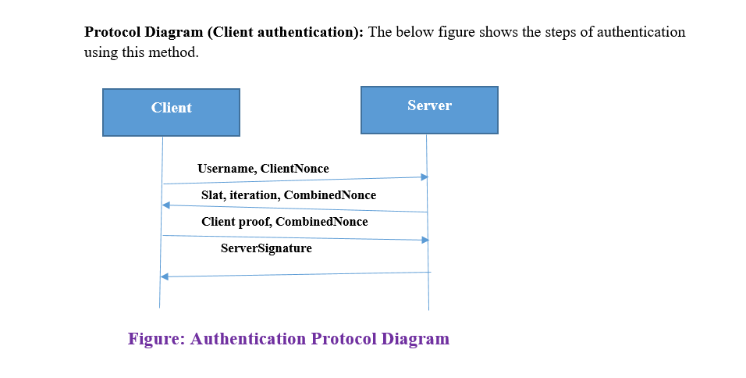
Securing BigData

Slide 17
Comparison of Hadoop/MongoDB based security :
To store and process BigData Hadoop and MongoDB are good enough.
Hadoop doesn’t have the built-in security and MongoDB does not have in some places like data encryption at rest needs to be taken care by third party tools such as ‘volumetric data security’.
Hadoop is basically built for storing and processing BigData and not security in place. Whereas MongoDB has built-in security such as role based access control, auditing and SCRAM-SHA-1.
Conclusion:
BigData security can be improved by following the above discussed security methods using Hadoop and MongoDB tools.
Organizations can improve their security and data is secured from vulnerability.

Slide 18
Securing BigData
Thank You ..!

